Slide 1







TechJobHub
Your gateway to tech careers

Slide 2


Team
Jarin Thasnin Ahmed
BKH2125006F
Year- 03, Term- 01
Mail: jarin2516@student.nstu.edu.bd
Shaila Rahaman
BBH2125007F
Year- 03, Term- 01
Mail: shaila2516@student.nstu.edu.bd
Makmudul Hasan Rabbi
ASH2125008M
Year- 03, Term- 01
Mail: rabbi2516@student.nstu.edu.bd
Majedur Rahman
ASH2125021M
Year- 03, Term- 01
Mail: majedur2516@student.nstu.edu.bd

Slide 3


INTRoDUCTION
TechJobHub is an online platform changing how people find jobs and hire employees. It's like a personal career advisor for job seekers, helping them match their skills with the right job. Recruiters also can post jobs, set tests, and do interviews online. It's not just about finding jobs; it's a friendly place where job seekers and recruiters benefit together. Whether experienced or new, TechJobHub is the key to success in the digital realm..

Slide 4


User login and register
Job Search
Job Posting
Upload Resume
Parse Resume
Skills Matching
Job Recommendation
Apply Job
Assessment
Confidential Rating
Confirmation
FUNCTIONAL REQUIREMENTS

Slide 5
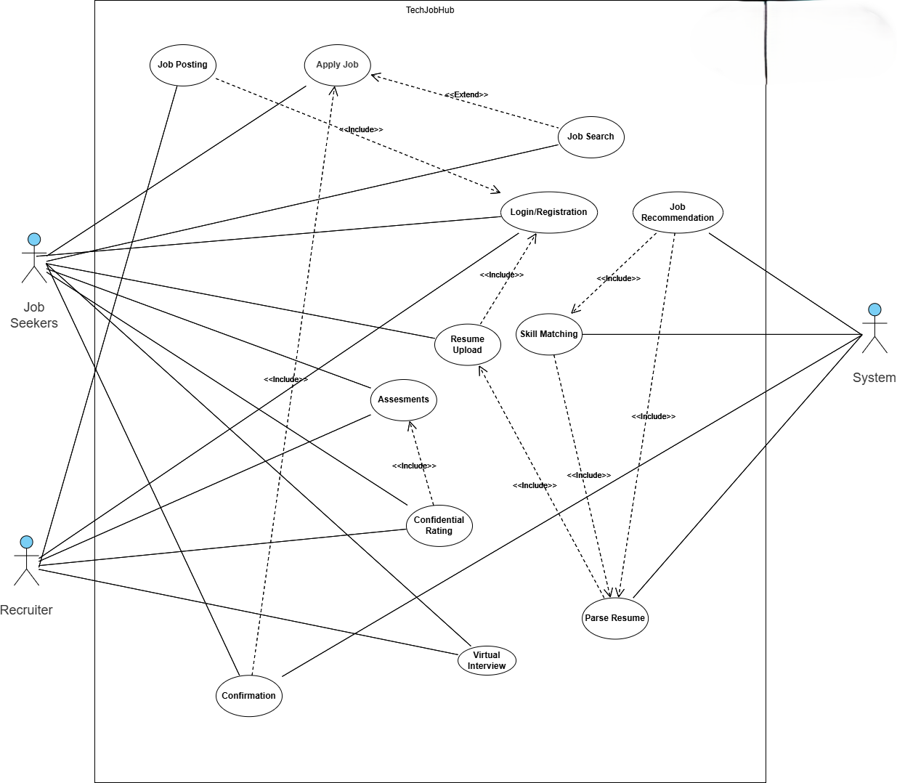


USE CASE

Slide 6

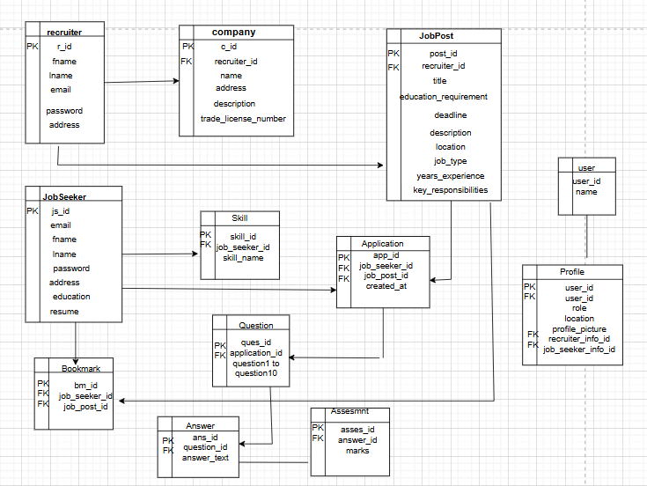
DATABASE DESIGN

Slide 7


LANGUAGES & TOOLS
Frontend Development:
HTML
CSS
JavaScript
Backend Development:
Python
Django
NLP (Natural Language Processing)
Database Management:
SQL (Structured Query Language
VS Code

Slide 8

ANY QUERY

Slide 9
Thank You

